Slide 1
COMPOSITE - EXERSAMPLE !
Considere o exemplo de Caixas e Objetos mostrado
Queremos aplicar duas funcionalidades de forma a tratar os diferentes objetos (caixas e objetos) da mesma forma:
Calcular o preço deve funcionar tanto para uma caixa quanto para um objeto
Listar infos básicas também deve funcionar tanto para a caixa quanto para um objeto
A saída esperada é esta ao lado →
Complete o código-fonte a seguir →
This is the Box 1
--> Element: Object 1
--> Element: Object 2
--> Element: Box 2
This is the Box 2
--> Element: Object 3
--> Element: Object 4
--> Element: Box 4
This is the Box 3
--> Element: Object 5
--> Element: Object 6
---- PRICES -----
The price of box1 is 40
The price of box2 is 20
The price of box3 is 20

Slide 2
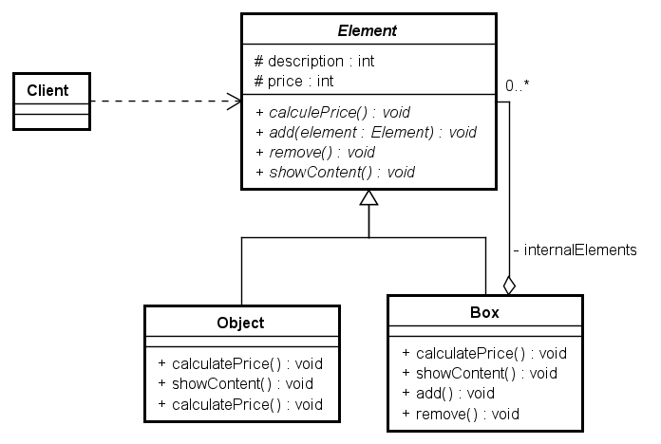
COMPOSITE - EXERSAMPLE !
Concrete
Modeling (Implementation)

Slide 3
COMPOSITE - EXERSAMPLE !
public class Client {
public static void main(String args[]) {
Element object1 = new Object("Object 1");
Element object2 = new Object("Object 2");
Element object3 = new Object("Object 3");
Element object4 = new Object("Object 4");
Element object5 = new Object("Object 5");
Element object6 = new Object("Object 6");
Element box1 = new Box("Box 1");
Element box2 = new Box("Box 2");
Element box3 = new Box("Box 3");
Folhas !
Todos são
elementos !
This is the client code
Composite !

Slide 4
COMPOSITE - EXERSAMPLE !
box1.add(object1);
box1.add(object2);
box1.add(box2);
box2.add(object3);
box2.add(object4);
box2.add(box3);
box3.add(object5);
box3.add(object6);
box1.showContent();
box2.showContent();
box3.showContent();
System.out.println("---- PRICES -----");
System.out.println("The price of box1 is " + box1.calculatePrice());
System.out.println("The price of box2 is " + box2.calculatePrice());
System.out.println("The price of box3 is " + box3.calculatePrice());
}
}
Como o método add() recebe um Element, posso passar tanto caixas quanto objetos !

Slide 5
COMPOSITE - EXERSAMPLE !
public abstract class Element {
protected String description;
protected int price;
public Element(String description) {
this.description = description;
}
abstract public void add(Element newElement);
abstract public void remove(int i);
public abstract void showContent();
public abstract int calculatePrice();
}

Slide 6
COMPOSITE - EXERSAMPLE !
public class Box extends ??? {
??????
List internalElements = Elements[]
public Box(String description) {
super(description);
}
public void add(Element newElement) {
if (!newElement.equals(this)) {
????.add(newElement);
}
else {
System.out.println("It is not possible to add the same element !");
}
}
public void remove(int i) {
????.remove(i);
}

Slide 7
COMPOSITE - EXERSAMPLE !
public void showContent() {
System.out.println("This is the " + this.description);
for (int i=0; i < ?????.size(); i++) {
???? = ????.get(i); // Element e = internalElements.get(i)
System.out.println(" --> Element: " + ???.description);
}
}
public int calculatePrice() {
int sum = 0;
???;
for (int i=0; i < ?????.size(); i++) {
??? = internalElements.get(i);
sum = sum + element.calculatePrice();
}
return sum;
}

Slide 8
COMPOSITE - EXERSAMPLE !
public class Object extends ???? {
public Object(String description) {
super(description);
}
public void add(Element newElement) {
// TODO Auto-generated method stub
}
public void remove(int i) {
// TODO Auto-generated method stub
}
public void showContent() {
System.out.println("This is the " + this.description);
}
public int calculatePrice() {
return 10;
}
}

Slide 9
COMPOSITE - PHYTON EXERSAMPLE !
if __name__ == "__main__":
object1: Element = Object("Object1")
object2: Element = Object("Object2")
object3: Element = Object("Object3")
object4: Element = Object("Object4")
object5: Element = Object("Object5")
object6: Element = Object("Object6")
box1: Element = Box("Box1")
box2: Element = Box("Box2")
box3: Element = Box("Box3")
box4: Element = Box("Box4")
box1.add(object1)
box1.add(object2)
box1.add(box2)
box2.add(object3)
box2.add(object4)
box2.add(box4)
box3.add(object5)
box3.add(object6)
box1.showcontent()
box2.showContent()
box3.showContent()
print("-----PRICES-----")
print("The price of box1 is %s", box1.calculatePrice())
print("The price of box2 is %s", box2.calculatePrice())
print("The price of box3 is %s", box3.calculatePrice())
This is the client code

Slide 10
COMPOSITE - PHYTON EXERSAMPLE !
class Element():
_description: str = None
_price: int = None
def __init__(self, description: str) -> None:
self._description = description
def add(self, element: Element) -> None:
raise NotImplementedError
def remove(self, i: int) -> None:
raise NotImplementedError
def showContent(self) -> None:
raise NotImplementedError
def calculatePrice(self) -> int:
raise NotImplementedError

Slide 11
COMPOSITE - PHYTON EXERSAMPLE !
class Box(???):
??????
def __init__(self, descrption: str) -> None:
super().__init__(descrption)
def add(self, element: Element) -> None:
if isinstance(element, self) :
print("It is not possible to add the same element !")
else:
???.attach(element)
def remove(self, element: Element) -> None:
????.remove(element)
def showContent(self) -> None:
print("This is the %s", self._description)
for e in ???:
print("--> Element: %s", e._description())
def calculatePrice(self) -> int:
sum: int = 0
???
for e in ???:
sum = sum + e.calculatePrice()
return sum

Slide 12
COMPOSITE - PHYTON EXERSAMPLE !
class Object(???):
def __init__(self, description: str) -> None:
super().__init__(description)
def add(self, element: Element) -> None:
pass
def remove(self, i: int) -> None:
pass
def showContent(self) -> None:
print("This is the %s", self._description())
def calculatePrice(self) -> int:
return 10

